Slide 1

CSE 473: Pattern Recognition

Slide 2
Syntactic Pattern Recognition

Slide 3
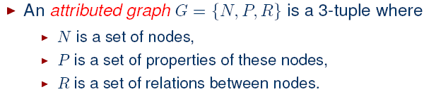
Extension to Graph Matching Approach

Slide 4
Matching Through Attributed Graph
Assignment of nodes:

Slide 5

Matching Through Attributed Graph
Assignment of nodes:
Nodes n₁ ∈ N₁ and n₂ ∈ N₂ are said to form an assignment (n₁, n₂) if

Slide 6



Matching Through Attributed Graph
Compatibility of assignments:

Slide 7
Matching Through Attributed Graph
Compatibility of assignments:
n₂
n₁
n’₂
G₁
G₂
n’₁

Slide 8
Matching Through Attributed Graph
Compatibility of assignments:
n₂
n₁
n’₂
G₁
G₂
n’₁

Slide 9
Matching Through Attributed Graph
Compatibility of assignments:
n₂
n₁
n’₂
G₁
G₂
n’₁

Slide 10
Matching Through Attributed Graph
Assignment and Isomorphism:
Two attributed graphs G₁ and G₂ are isomorphic if there exists a set of 1:1 assignments of nodes in G₁ to nodes in G₂ such that all assignments are compatible.

Slide 11
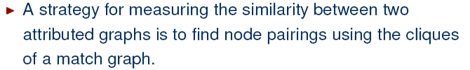
Matching Through Attributed Graph
G₁
G₂
Match Graph
Maximal Clique
Calculate Measure of Graph Similarity

Slide 12
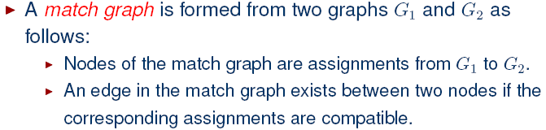
Matching Through Attributed Graph

Slide 13

Matching Through Attributed Graph

Slide 14
Approaches in Matching Through Attributed Graph
Steps
  draw attributed graphs from the patterns
  draw match graphs from the attributed graph
  find the maximum clique from the match graph
  calculate the similarity

Slide 15
Recursive Procedure to Find Cliques
Input:
  X: an initial clique (possibly empty)
  Y: the graph
Output:
  The set of all maximal cliques

Slide 16
Recursive Procedure to Find Cliques
Procedure clique (X, Y)
Form Y – X;
If a node y in Y – X is connected to all nodes of X,
Then return cliques (X U {y},Y) U cliques (X,Y-{y})
Else return X
End

Slide 17
Recursive Procedure to Find Cliques
Procedure clique (X, Y)
Form Y – X;
If a node y in Y – X is connected to all nodes of X,
Then return cliques (X U {y},Y) U cliques (X,Y-{y})
Else return X
End
a
d
b
c

Slide 18
Recursive Procedure to Find Cliques
Procedure clique (X, Y)
Form Y – X;
If a node y in Y – X is connected to all nodes of X,
Then return cliques (X U {y},Y) U cliques (X,Y-{y})
Else return X
End
Find clique (d, Y)?
a
d
b
c

Slide 19
Recursive Procedure to Find Cliques
Procedure clique (X, Y)
Form Y – X;
If a node y in Y – X is connected to all nodes of X,
Then return cliques (X U {y},Y) U cliques (X,Y-{y})
Else return X
End
clique (d, Y) = clique ({d, b}, Y) U
clique (d, {a, c, d})
a
d
b
c

Slide 20
Recursive Procedure to Find Cliques
Procedure clique (X, Y)
Form Y – X;
If a node y in Y – X is connected to all nodes of X,
Then return cliques (X U {y},Y) U cliques (X,Y-{y})
Else return X
End
clique (d, Y) = clique ({d, b}, Y) U
clique (d, {a, c, d})
clique ({d, b}, Y) = clique ({d, b, c}, Y) U
clique ({d, b}, {a, b, d})
a
d
b
c

Slide 21
Recursive Procedure to Find Cliques
Procedure clique (X, Y)
Form Y – X;
If a node y in Y – X is connected to all nodes of X,
Then return cliques (X U {y},Y) U cliques (X,Y-{y})
Else return X
End
clique (d, Y) = clique ({d, b}, Y) U
clique (d, {a, c, d})
clique ({d, b}, Y) = clique ({d, b, c}, Y) U
clique ({d, b}, {a, b, d})
a
d
{d, b}
b
c

Slide 22
Recursive Procedure to Find Cliques
Procedure clique (X, Y)
Form Y – X;
If a node y in Y – X is connected to all nodes of X,
Then return cliques (X U {y},Y) U cliques (X,Y-{y})
Else return X
End
clique (d, Y) = clique ({d, b}, Y) U
clique (d, {a, c, d})
clique ({d, b}, Y) = clique ({d, b, c}, Y)
U {d, b}
a
d
{d, b, c}
b
c

Slide 23
Recursive Procedure to Find Cliques
Procedure clique (X, Y)
Form Y – X;
If a node y in Y – X is connected to all nodes of X,
Then return cliques (X U {y},Y) U cliques (X,Y-{y})
Else return X
End
clique (d, Y) = clique ({d, b}, Y) U
clique (d, {a, c, d})
clique ({d, b}, Y) = {d, b, c} U {d, b}
a
d
b
c

Slide 24
Recursive Procedure to Find Cliques
Procedure clique (X, Y)
Form Y – X;
If a node y in Y – X is connected to all nodes of X,
Then return cliques (X U {y},Y) U cliques (X,Y-{y})
Else return X
End
clique (d, Y) = clique ({d, b}, Y) U
clique (d, {a, c, d})
clique ({d, b}, Y) = {d, b, c} U {d, b}
= {d, b, c}
a
d
b
c

Slide 25
Recursive Procedure to Find Cliques
Procedure clique (X, Y)
Form Y – X;
If a node y in Y – X is connected to all nodes of X,
Then return cliques (X U {y},Y) U cliques (X,Y-{y})
Else return X
End
clique (d, Y) = {d, b, c} U {d, b} U
clique (d, {a, c, d})
a
d
b
c

Slide 26
Recursive Procedure to Find Cliques
Procedure clique (X, Y)
Form Y – X;
If a node y in Y – X is connected to all nodes of X,
Then return cliques (X U {y},Y) U cliques (X,Y-{y})
Else return X
End
clique (d, Y) = {d, b, c} U {d, b} U
clique (d, {a, c, d})
clique (d, {a, c, d})
= clique ({d, c}, {a, c, d})
U clique (d, {a, d})
a
d
b
c

Slide 27
Recursive Procedure to Find Cliques
Procedure clique (X, Y)
Form Y – X;
If a node y in Y – X is connected to all nodes of X,
Then return cliques (X U {y},Y) U cliques (X,Y-{y})
Else return X
End
clique (d, Y) = {d, b, c} U {d, b} U
clique (d, {a, c, d})
clique (d, {a, c, d})
= clique ({d, c}, {a, c, d})
U clique (d, {a, d})
={d, c} U {d}
a
d
b
c

Slide 28
Recursive Procedure to Find Cliques
Procedure clique (X, Y)
Form Y – X;
If a node y in Y – X is connected to all nodes of X,
Then return cliques (X U {y},Y) U cliques (X,Y-{y})
Else return X
End
clique (d, Y) = {d, b, c} U {d, b}
U {d, c} U {d}
a
d
b
c

Slide 29
Recursive Procedure to Find Cliques
Procedure clique (X, Y)
Form Y – X;
If a node y in Y – X is connected to all nodes of X,
Then return cliques (X U {y},Y) U cliques (X,Y-{y})
Else return X
End
The maximal clique is = {d, b, c}
a
d
b
c

Slide 30
Example: Pattern Matching Using Attributed Graph
P
T

Slide 31
Example: Pattern Matching Using Attributed Graph
P
T
Reference
Reference

Slide 32
Example: Pattern Matching Using Attributed Graph
P
T
Reference
Test
Reference

Slide 33
Example: Pattern Matching Using Attributed Graph
Find Attributed Graph for all patterns
a
a
e
d
b
b
c
d
e
c
AG
l₁
l₁
Horizontal line
Vertical line
Relation: connected

Slide 34
Example: Pattern Matching Using Attributed Graph
Find Attributed Graph for all patterns
a
a
a’
b’
e
b
a’
d
c’
d’
b
b’
c
d
e
c
d’
AG
c’
l₁
l₁
l₂
AG
l₂
a”
a”
b”
b”
Horizontal line
Vertical line
Relation: connected
c”
c”
u
AG_{u}

Slide 35
Example: Pattern Matching Using Attributed Graph
Find Matched Graph between AGl₁ and AG_{u}
a
a”
e
b”
b
d
c”
c
AG
AG_{u}
l₁

Slide 36
Example: Pattern Matching Using Attributed Graph
Find Matched Graph between AGl₁ and AG_{u}
a
a”
e
Find all assignments between AGl₁ and AG_{u}:
(a, a”), (b, b”), (b, c”), (c, a”),
(d, b”), (d, c”), (e, b”), (e, c”)
b”
b
d
c”
c
AG
AG_{u}
l₁

Slide 37
Example: Pattern Matching Using Attributed Graph
Find Matched Graph between AGl₁ and AG_{u}
a
a”
a, a”
e
e, c”
b”
b
e, b”
b, b”
d
c”
c
AG
AG_{u}
l₁
d, c”
b, c”
d, b”
c, a”
Find all assignments between AGl₁ and AG_{u}

Slide 38
Example: Pattern Matching Using Attributed Graph
Find Matched Graph between AGl₁ and AG_{u}
a
a”
a, a”
e
e, c”
b”
b
e, b”
b, b”
d
c”
c
AG
AG_{u}
l₁
d, c”
b, c”
d, b”
c, a”
Connect the compatible assignments

Slide 39
Example: Pattern Matching Using Attributed Graph
Find Matched Graph between AGl₁ and AG_{u}
a
a”
a, a”
e
e, c”
b”
b
e, b”
b, b”
d
c”
c
AG
AG_{u}
l₁
d, c”
b, c”
a, a”
e, c”
d, b”
c, a”
Find the maximal clique: {(a, a”),(d, b”), (e, c”)}
d, b”

Slide 40
Example: Pattern Matching Using Attributed Graph
Find Matched Graph between AGl₁ and AG_{u}
a
a”
a, a”
e
e, c”
b”
b
d
c”
c
AG
AG_{u}
l₁
d, b”
(a, a”)
(d, b”)
Visual Representation
(e, c”)

Slide 41
Example: Pattern Matching Using Attributed Graph
Find Matched Graph between AGl₁ and AG_{u}
a’
a”
d’
b’
b”
c’
c”
AG
AG_{u}
l₂

Slide 42
Example: Pattern Matching Using Attributed Graph
Find Matched Graph between AGl₁ and AG_{u}
a’
a”
d’
Find all assignments between AGl₂ and AG_{u}:
(a’, a”), (b’, a”), (c’, b”),
(c’, c”), (d’, b”), (d’, c”)
b’
b”
c’
c”
AG
AG_{u}
l₂

Slide 43
Unsupervised Learning:
Clustering

Slide 44
What is Cluster Analysis?
Finding groups of objects such that the objects in a group will be similar (or related) to one another and different from (or unrelated to) the objects in other groups
Inter-cluster distances are maximized
Intra-cluster distances are minimized

Slide 45
Applications
Understanding
  Biological taxonomy
  Group related documents for browsing
  Group genes and proteins that have similar functionality
  Group stocks with similar price fluctuations
Summarization
  Reduce the size of large data sets
Data Compression
  Vector quantization
Finding nearest neighbor

Slide 46
Applications .. .
Hypothesis generation
  To infer some hypothesis
Hypothesis testing
  To verify an existing hypothesis
  Example: ‘big companies invest overseas’
Prediction based on groups
  Predict unknown patterns

Slide 47
What is not Cluster Analysis?
Supervised classification
  Have class label information
Simple segmentation
  Dividing students into different registration groups alphabetically, by last name
Results of a query
  Groupings are a result of an external specification

Slide 48
Clustering Basis
Basic Concepts
a clustering criterion must first be adopted.
Different criteria lead to different clusters.

Slide 49
Notion of a Cluster can be Ambiguous
  Depending on the similarity measure, the clustering criterion and the clustering algorithm, different clusters may result. Subjectivity is a reality to live with from now on.

Slide 50
Notion of a Cluster can be Ambiguous
  Depending on the similarity measure, the clustering criterion and the clustering algorithm, different clusters may result. Subjectivity is a reality to live with from now on.
How many clusters?
Six Clusters
Two Clusters
Four Clusters

Slide 51
Notion of a Cluster can be Ambiguous
Let these animals to be clustered
  Blue shark, sheep, cat, Dog, Lizard, sparrow, viper, seagull, gold fish, frog, red mullet

Slide 52
  A real example
Blue shark,
sheep, cat,
dog
Lizard, sparrow, viper, seagull, gold fish, frog, red mullet
Two clusters
Clustering criterion:
How mammals bear
their progeny
Gold fish, red mullet, blue shark
Sheep, sparrow,
dog, cat, seagull,
lizard, frog, viper
Two clusters
Clustering criterion:
Existence of lungs

Slide 53
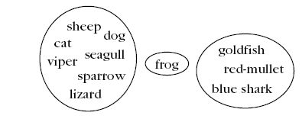
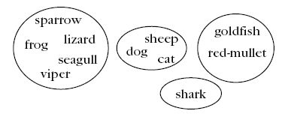
  A real example
Three clusters
Clustering criterion:
Their living
environment
Four clusters
Clustering criterion:
Bear progeny and Existence of lungs

Slide 54
Clustering Task Stages
  Feature Selection: Information rich features-Parsimony
  Proximity Measure: This quantifies the term similar or dissimilar.
  Clustering Criterion: This consists of a cost function or some type of rules.
  Clustering Algorithm: This consists of the set of steps followed to reveal the structure, based on the similarity measure and the adopted criterion.
  Validation of the results.
  Interpretation of the results.

Slide 55
Types of Features
With respect to their domain
  Continuous (the domain is a continuous subset of ℜ).
  Discrete (the domain is a finite discrete set).
    Binary or dichotomous (the domain consists of two possible values).
With respect to the relative significance of the values they take
  Nominal (the values code states, e.g., the home district of an individual).
  Ordinal (the values are meaningfully ordered, e.g., the rating of the services of a hotel (poor, good, very good, excellent)).
  Interval-scaled (the difference of two values is meaningful but their ratio is meaningless, e.g., temperature).
  Ratio-scaled (the ratio of two values is meaningful, e.g., weight).

Slide 56
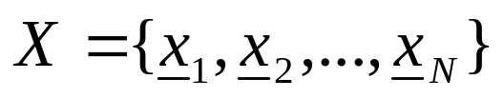
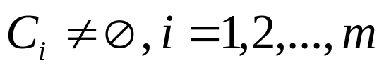
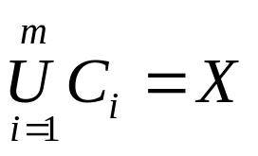
Clustering Definitions
Hard Clustering: Each point belongs to a single cluster
    Let
    An m-clustering R of X, is defined as the partition of X into m sets (clusters), C₁, C₂,…,C_{m}, so that
  In addition, data in C_{i} are more similar to each other and less similar to the data in the rest of the clusters.

Slide 57


Clustering Definitions
  Fuzzy clustering: Each point belongs to all clusters up to some degree.
  A fuzzy clustering of X into m clusters is characterized by m functions
    is the representative of jth cluster

Slide 58
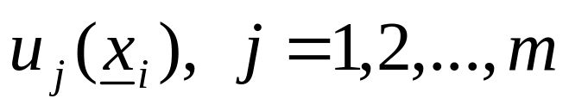
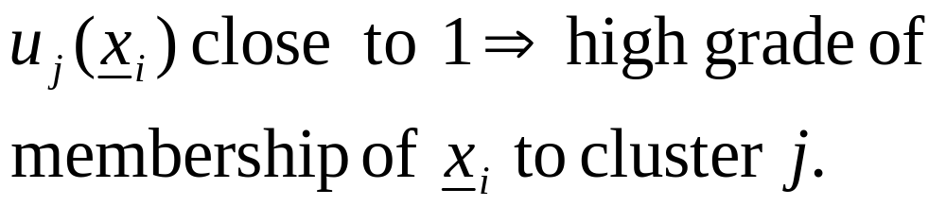
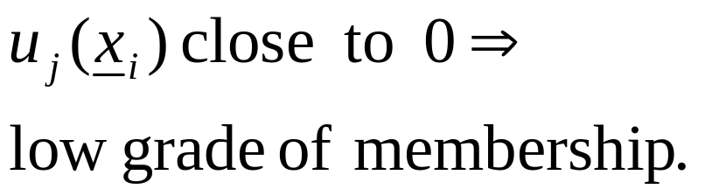
Clustering Definitions
  These are known as membership functions.
  Thus, each x_{i} belongs to any cluster “up to
  some degree”, depending on the value of

Slide 59
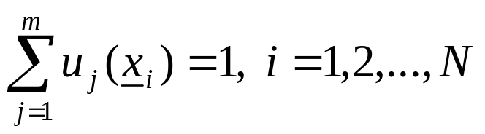
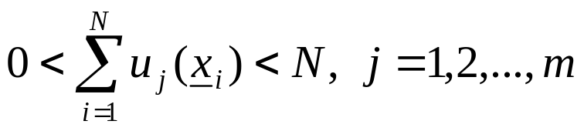
Clustering Definitions
  Fuzzy clustering: Each point belongs to all clusters up to some degree.
  A fuzzy clustering of X into m clusters is characterized by m functions
    is the representative of jth cluster

Slide 60
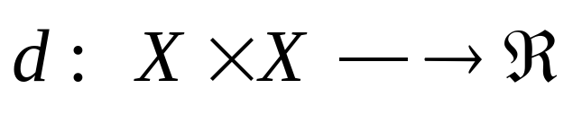
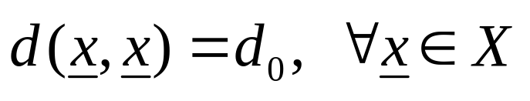
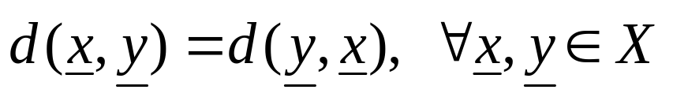
Proximity Measures
Between vectors
  Dissimilarity measure (between vectors of X) is a function
with the following properties

Slide 61
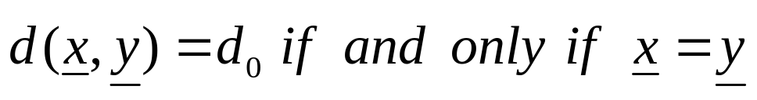
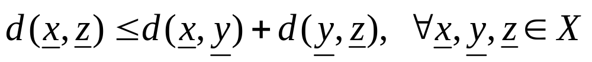
Proximity Measures
If, in addition
  (triangular inequality)
  d is called a metric dissimilarity measure.

Slide 62
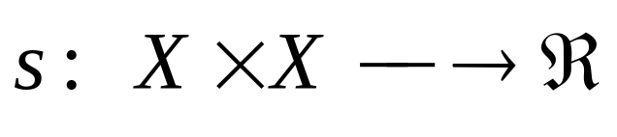
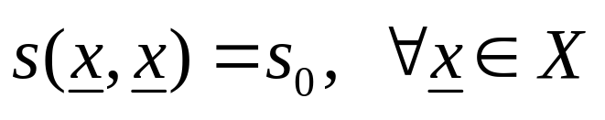
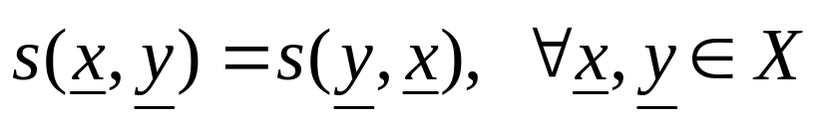
Proximity Measures
  Similarity measure (between vectors of X) is a function
with the following properties

Slide 63
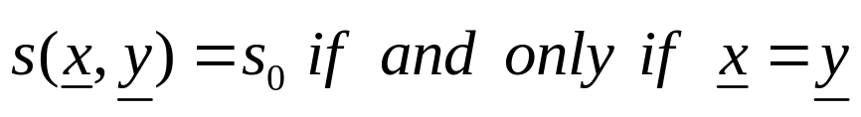
Proximity Measures
If, in addition
  s is called a metric similarity measure.

Slide 64
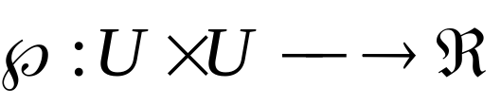
Proximity Measures
Between sets
Let D_{i} ⊂ X, i=1,…,k and U={D₁,…,D_{k}}
A proximity measure ℘ on U is a function

Slide 65
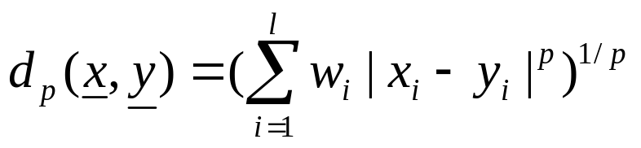
Proximity Measures Between Points/Vectors
Real-valued vectors
  Dissimilarity measures (DMs)
    Weighted l_{p} metric DMs
    Interesting instances are obtained for
      p=1 (weighted Manhattan norm)
      p=2 (weighted Euclidean norm)
      p=∞ (d∞(x,y)=max_{1≤i≤l} w_{i}|x_{i}-y_{i}| )

Slide 66
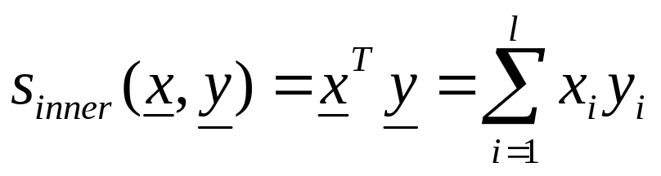
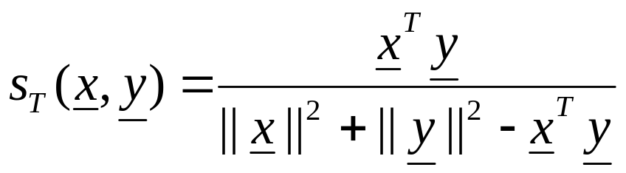
Proximity Measures Between Vectors
  Similarity measures
    Inner product
    Tanimoto measure

Slide 67

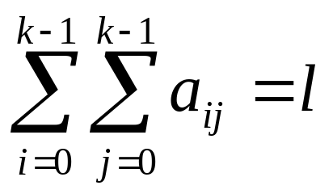
Proximity Measures Between Discrete-Valued Vectors
  Let F={0,1,…,k-1} be a set of symbols and X={x₁,…,x_{N}} ⊂ F^{l}
  Let A(x,y)=[a_{ij}], i, j=0,1,…,k-1, where a_{ij} is the number of places where x has the i-th symbol and y has the j-th symbol.
Example: l=6, k =3
NOTE:

Slide 68
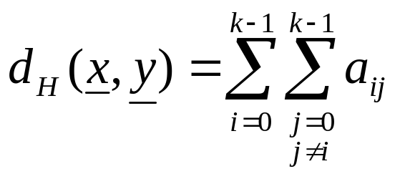
Proximity Measures Between Discrete-Valued Vectors
Several proximity measures can be expressed as combinations of the elements of A(x,y).
  Dissimilarity measures:
    The Hamming distance (number of places where x and y differ)

Slide 69
Proximity Measures Between Discrete-Valued Vectors
Several proximity measures can be expressed as combinations of the elements of A(x,y).
  Dissimilarity measures:
    The Hamming distance (number of places where x and y differ)

Slide 70
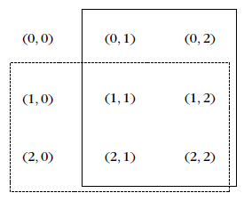
Proximity Measures Between Discrete-Valued Vectors
n_{y}
  Similarity measures:
n_{x}

Slide 71
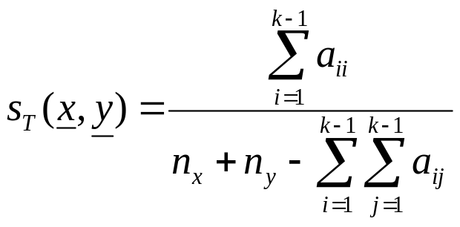
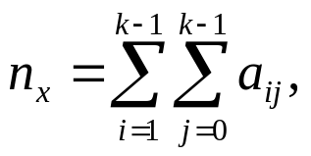
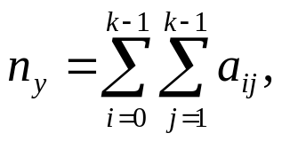
Proximity Measures Between Discrete-Valued Vectors
n_{y}
  Similarity measures:
n_{x}
    Tanimoto measure :
    where

Slide 72
Proximity Measures Between Discrete-Valued Vectors
n_{y}
  Similarity measures:
n_{x}
    Tanimoto measure :
    where

